Slide 1
Object Oriented Programming Week-1 Aug 22-27, 2022
Instructor:
Dr. Abdul Aziz
Assistant Professor
(School of Computing)
National University- FAST (KHI Campus)

Slide 2
acknowledgment
- Publish material by Virtual University of Pakistan.
- Publish material by Deitel & Deitel.
- Publish material by Robert Lafore.

Slide 3
Google Classroom Link
Please Join Using the code:
BCY-3A:
6zejwbr
BCS-3G
3n6pexa
BCS-3A
3um67f

Slide 4
What you have done so far !
- Introduction to Computer Programming (ITC):
How to think a program.
How to write a program.
Basic Programming structure.
Procedural paradigm.
Group of functions that interact with each other.
- Already have knowledge about the offered course.
- Need to strengthen our concepts.
- Try to implement what we know.

Slide 5
Computer Programming as a course
What we will study:
Object Oriented Programming.
How to think in a OOP way.
How to map real world into a program
Or, how to program a real world scenario.
Aim :
Our aim is to lean the concepts of Object Oriented programming.
Try to digest them.
Implement in a program.
Tool: C++.

Slide 6
Contents of the Course
- Object Oriented Programming.
- Classes & Objects.
- Overloading.
- Inheritance.
- Polymorphism.
- Generic Programming.
- Exception Handling.

Slide 7
Books
Text Book:
1- C++ How to program By Deitel & Deitel.
Reference Books:
1- The C++ Programming Language By Bjarne Stroustrup.
2- Object Oriented Software Engineering By Jacobson.

Slide 8
Grading policy
Assignments 10 at least four
Quiz 10 at least three
Midterm’s 30 two (15 marks each)
Final 50
_____
Total 100

Slide 9
—Chinese Proverb
Tell me and I forget.
Show me and I remember.
Let me do and I understand.

Slide 10
Week One, class one
- Introduction to the Generation of Languages
- Introduction to Software Development
- Introduction to Programming Paradigms

Slide 11
What Are the Types of Programming Languages
First Generation Languages
Second Generation Languages
Third Generation Languages
Fourth Generation Languages
Fifth Generation Languages

Slide 12
Software
► Computer Software is the product that software engineers design and build.
► It encompasses –programs that execute within a computer of any size and architecture,
– documents that encompass hard-copy and virtual forms,
– data that combine numbers and text but also includes representations of pictorial, video and audio information.

Slide 13
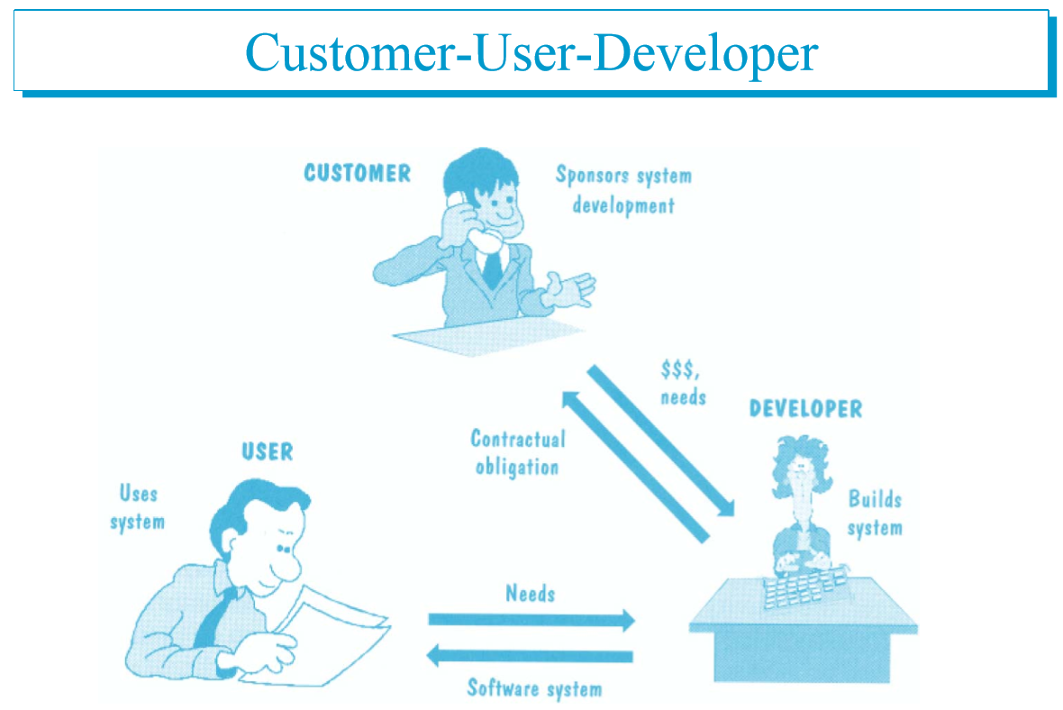

Slide 14
Solution vs problem Space

Slide 15
characteristics represent a pure approach to object-oriented programming
1-Everything is an object
2-A program is a bunch of objects telling each other what to do by sending message
3-Each object has its own memory made up of other objects
4-Every object has a type
5-All objects of a particular type can receive the same messages

Slide 16
Week one, class two
- Introduction to OO paradigm
- Principles of Object Oriented Paradigm

Slide 17
Programming Paradigms
1- Sequential
2- Procedural
3- Object Oriented

Slide 18
Programming Paradigms
Data Oriented
Process Oriented
Object Oriented
Think in term of data that we needed
Think in term of Process that we needed
Think in term of Object that is involved

Slide 19
What is object orientation
- A technique for system modeling.
- OO model consists of several interacting objects.

Slide 20
What is a Model?
- abstraction of something.
- Purpose is to understand the product before developing it.

Slide 21
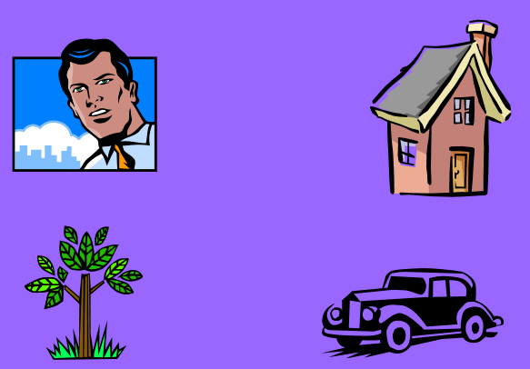
Example – OO Model

Slide 22
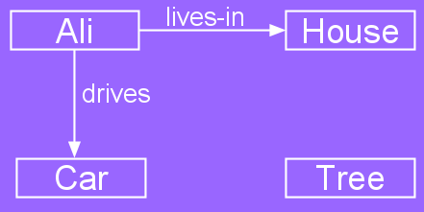
Example – OO Model
Objects
Person i.e Name: Ali
House
Car
Tree
Interactions
Ali lives in the house
Ali drives the car

Slide 23
Object-Orientation - Advantages
- People think in terms of objects
- OO models map to reality
Therefore, OO models are:
- easy to develop
- easy to understand

Slide 24
Five principles of OO paradigm
1- Abstraction: To have the relevant information.
2- Encapsulation: To hide information inside the object.
3- Polymorphism: To have many shapes / behaviors.
4- Inheritance: To create a new object with an existing one (To adopt features from others)
5- Reusability: Ability to use an object again and again if needed.

Slide 25
Week one, class three
- Introduction to Object

Slide 26
What is an Object?
An object is:
- It can be anything for which we want to save Information
- Something tangible (Ali, Car)
- Something that can be captured intellectually (Time, date)
An object has:
State / attributes / properties / data
Well-defined behavior / methods / functions
Unique identity

Slide 27
Ali as an object
Attributes:
Name
age
Behavior (operations)
Walks
Eats
Identity
His name

Slide 28
Car as an Object
State (attributes)
Color
Model
Behavior (operations)
Accelerate
Start Car
Change Gear
Identity
Its registration number

Slide 29
Visualizing an Object
Functions/Methods/Behavior
Objects Data / Attributes / States

